Slide 1
Introduction to OOAD
Semester Genap 2023/2024
D4-Teknik Informatika
Jurusan Teknologi Informasi
Analisis dan Desain Berorientasi Obyek

Slide 2
What is this
Object-Oriented Design
Designing software using Unified Modelling Language (UML).
Why?
Designing a system on a large scale is complicated.
The system can consist of various components and requirements.
How to share the design with the team or other people so it is easy to understand?
The solution is to use standard design methods → UML.
The advantage of UML is that it is compatible with the object-oriented programming paradigm.
Analisis dan Desain Berorientasi Obyek

Slide 3

UML
Unified Modelling Language, or UML, is a graphical modelling language that provides us with a syntax for describing the main elements (called artifacts in UML) of a software system.
Analisis dan Desain Berorientasi Obyek

Slide 4
UML
UML consists of several types of diagrams
Use-case diagram
Activity diagram
Class diagram
Object diagram
Sequence diagram
Communication diagram
Timing diagram
Interaction overview diagram
Composite structures
Component diagram
State machine diagram
Deployment diagram
Analisis dan Desain Berorientasi Obyek

Slide 5
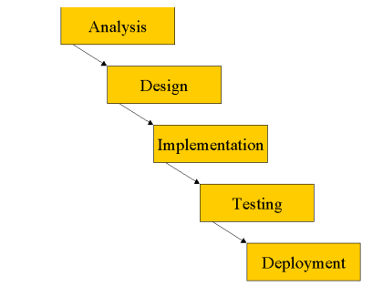
Model Waterfall
The Waterfall Model specifies that each stage must be completed before the next stage can begin.
The Waterfall Model is easy to understand and simple to manage. However, the advantages of this model begin to decline as project complexity increases.
Analisis dan Desain Berorientasi Obyek

Slide 6
Summary
UML is a graphical language for capturing software development artifacts.
The language provides us with notations for generating models.
UML is accepted as a single language used widely in industry.
The language is rich and brings many aspects of Software Engineering best practices.
Analisis dan Desain Berorientasi Obyek

Slide 7
Thanks!
Any Questions?

